Slide 1
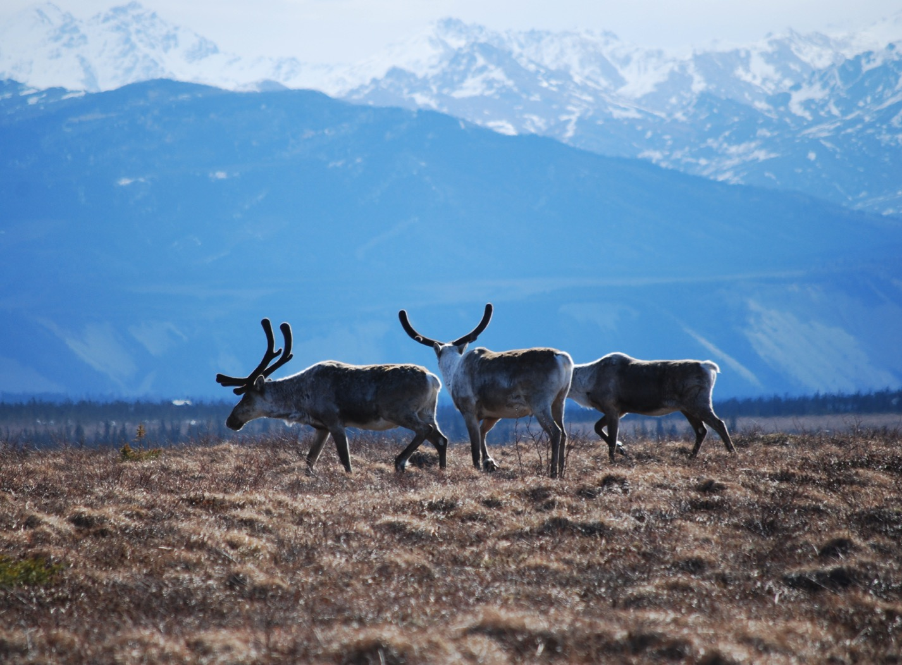
Arctic Boreal Vulnerability Experiment (ABoVE)
2017 ABoVE Airborne Campaign
18 July 2017 (DOY 199)
AVIRIS-NG: Interior Alaska
Charles Miller, Deputy Science Lead
Jet Propulsion Laboratory, California Institute of Technology
and the ABoVE Science Team For Hank Margolis, Eric Kasichke, Bruce Tagg
NASA HQ
2017

Slide 2
18 July 2017/DOY 199 Interior Alaska
Daily Status:
AVIRIS-NG / Dynamic Aviation B-200 (N53W)
REPORT DATE: 19 July 2017
Current Status of Aircraft: Yellow
Current Status of AVIRIS: GREEN
Current Deployment Location: Fairbanks AK (PAFA)
Crew: Rogers, Heidt, Nolte, Bernas
Science Coordinator: A Thorpe
Science Lead: C Miller
Project Managers: M Eastwood, I McCubbin
Instrument PI: R Green
Notes:
Aircraft avionics package continues to have intermittent loss of heading problems

Slide 3
18 July 2017/DOY 199 72-Hour Look Ahead
All plans weather dependent
Wednesday 19 July (DOY 200)
Old Crow Flats YT
Whitehorse YT
Thursday 20 July (DOY 201)
Yukon-Kuskokwim Delta
Deliver plane to Kenai
Friday 21 July – Friday 28 July: Avionics repair @ Kenai

Slide 4
18 July 2017/DOY 199 Interior Alaska

Slide 5
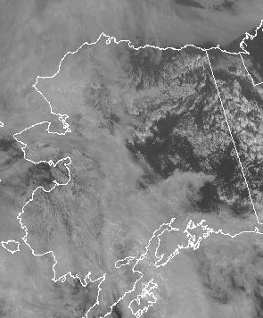
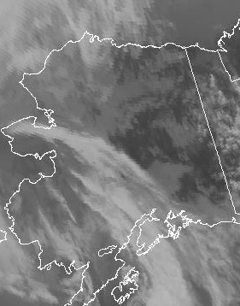
18 July 2017/DOY 199 Interior Alaska
GOES West Vis 2100Z
GOES West IR 2100Z

Slide 6
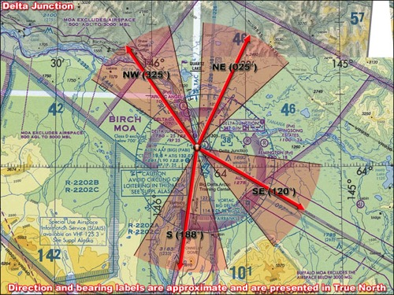
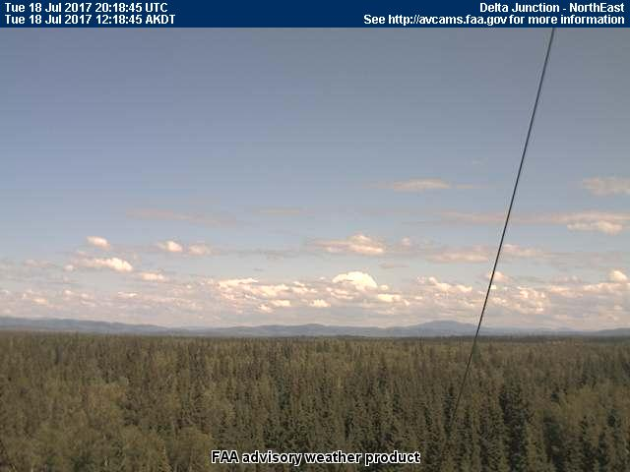
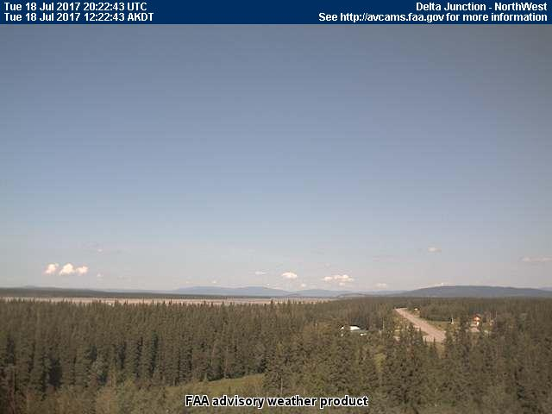
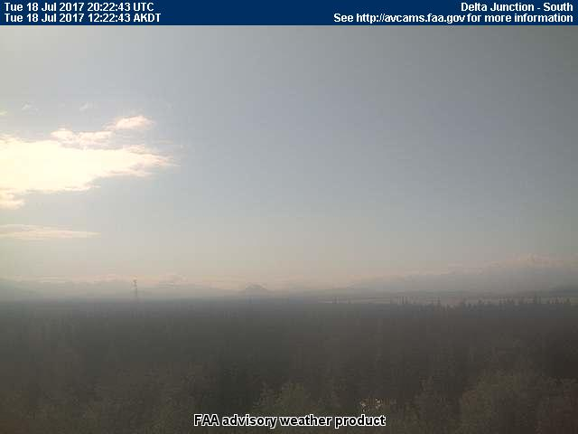
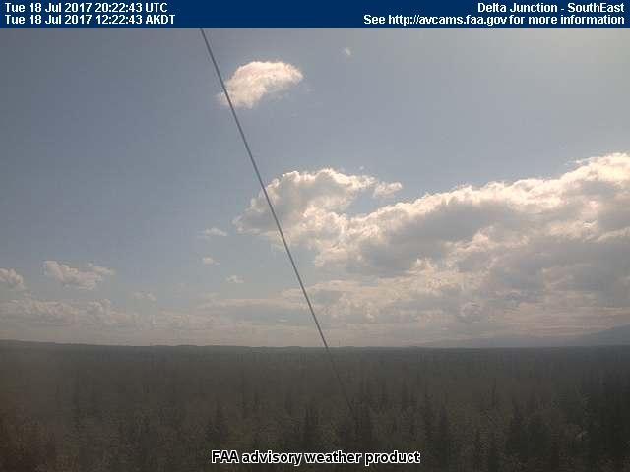
18 July 2017/DOY 199 Interior Alaska
Delta Junction
NORTH
Northeast
Northwest
South
Southeast
Notes:
Sortie #1: AVCAM sky pictures from Chalkyitsik showing open to partly cloudy skies and little smoke to the north and east (Old Crow), clear skies west and some high level cirrues to the SW
See http://avcams.faa.gov/ for an interactive map of Alaska aviation cameras

Slide 7
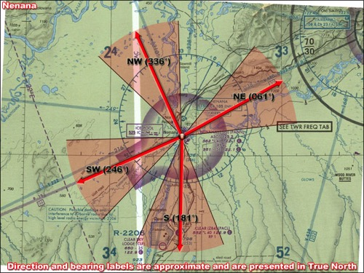
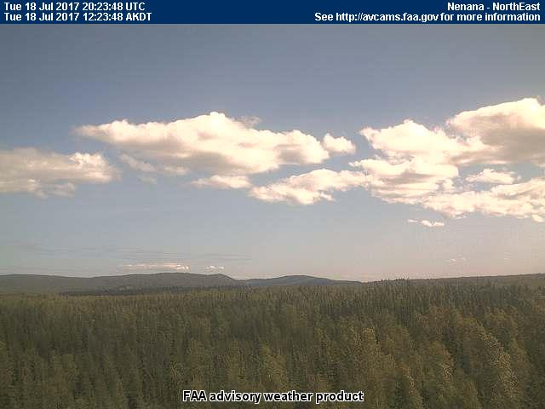
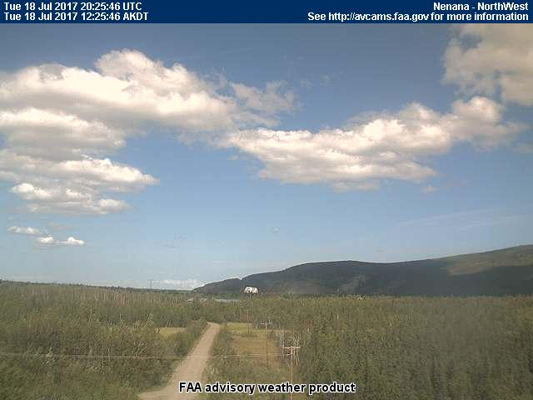
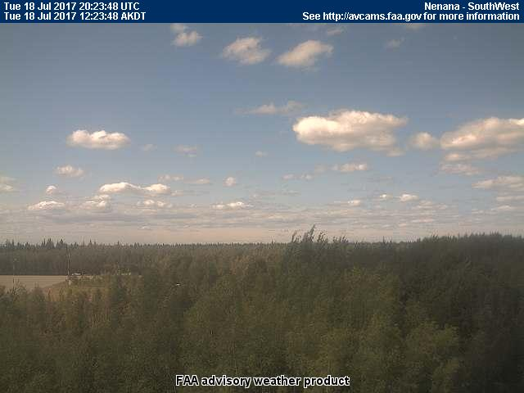
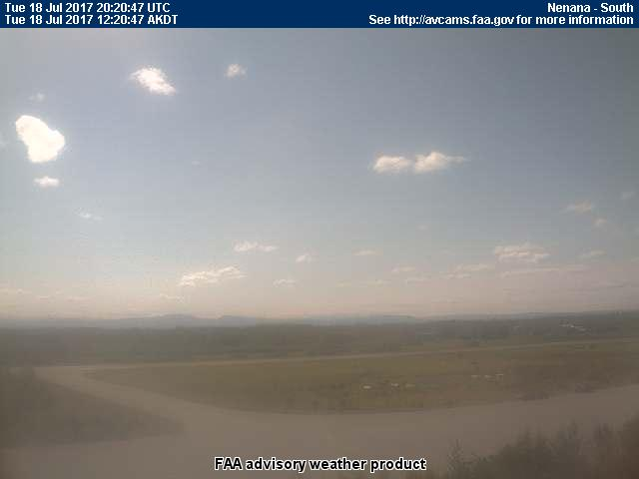
18 July 2017/DOY 199 Interior Alaska
Nenana
NORTH
Northeast
Northwest
Southwest
South
Notes:
Sortie #1: AVCAM sky pictures from Chalkyitsik showing open to partly cloudy skies and little smoke to the north and east (Old Crow), clear skies west and some high level cirrues to the SW
See http://avcams.faa.gov/ for an interactive map of Alaska aviation cameras

Slide 8
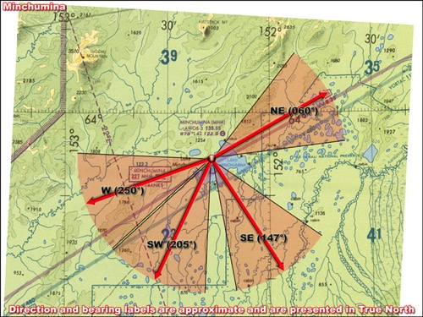
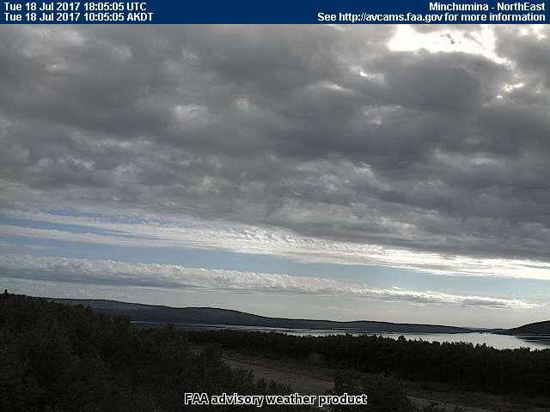
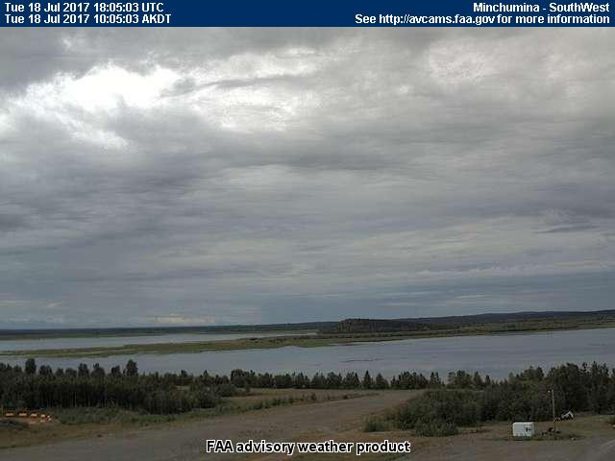
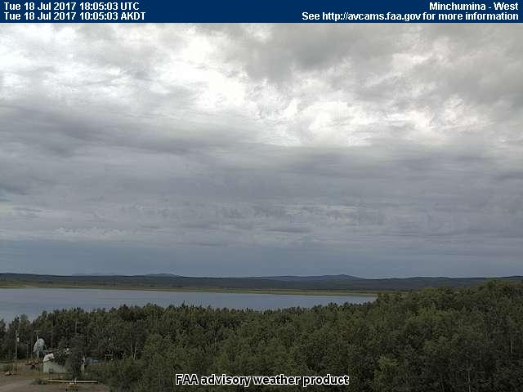
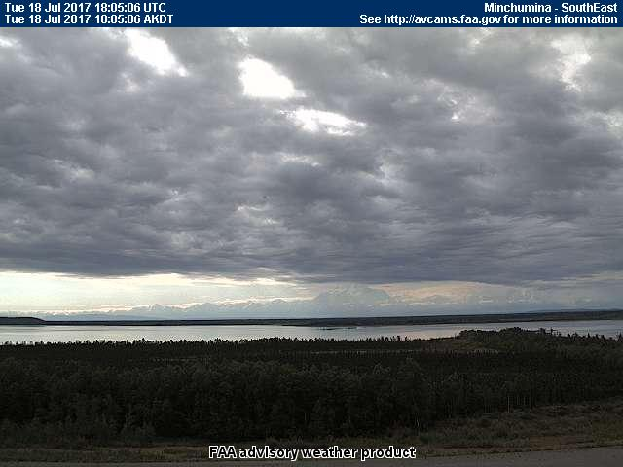
18 July 2017/DOY 199 Interior Alaska
Minchumina
NORTH
Northeast
West
Southwest
Southeast
Notes:
Sortie #1: AVCAM sky pictures from Chalkyitsik showing open to partly cloudy skies and little smoke to the north and east (Old Crow), clear skies west and some high level cirrues to the SW
See http://avcams.faa.gov/ for an interactive map of Alaska aviation cameras

Slide 9
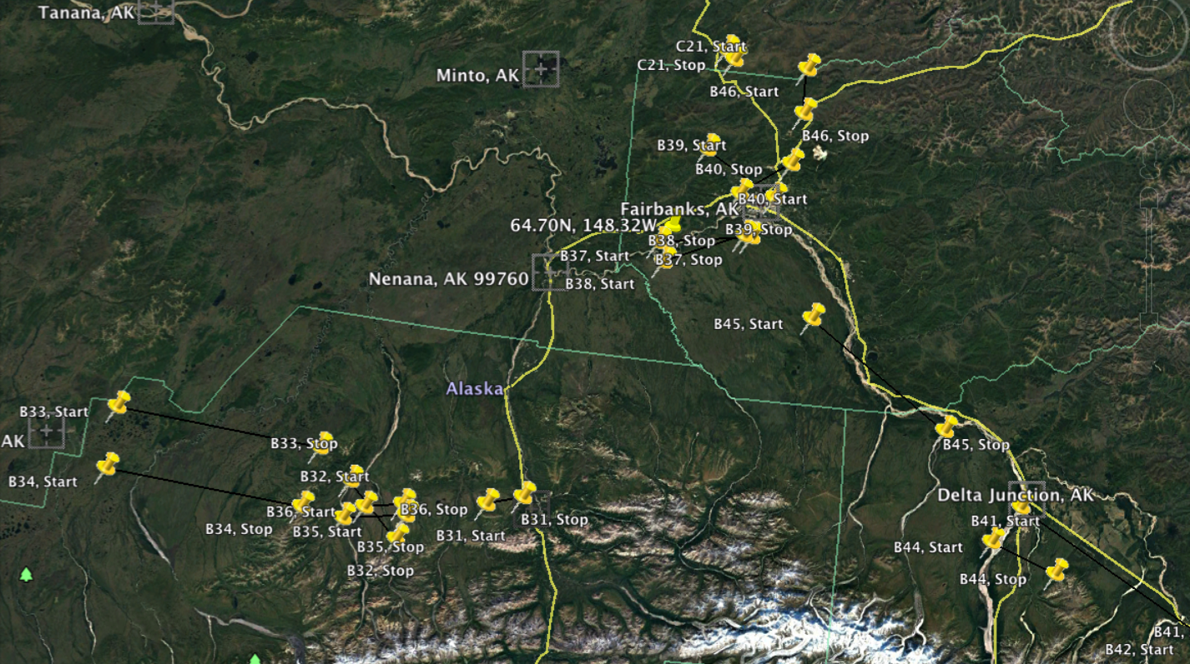
18 July 2017/DOY 199 Interior Alaska
Planned Flight Lines:
Interior Alaska
B40
Denali
B33
B34
B35
B44

Slide 10
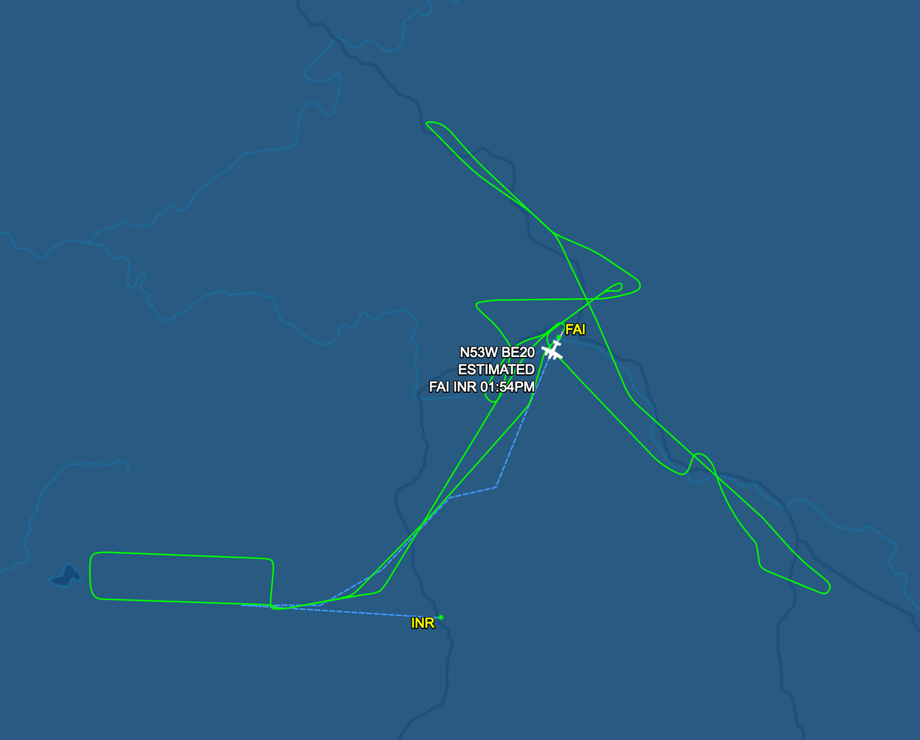
19 July 2017/DOY 200 Old Crow Flats & Whitehorse
As-flown Lines
C20
B40
Denali
B44
B33
B34
B35
Delta Junction

Slide 11
18 July 2017/DOY 199 Interior Alaska
Winston Olson-Duvall, JPL
AVIRIS-NG Quick-look products
https://avirisng.jpl.nasa.gov/cgi/flights.cgi?step=view_flightlog&flight_id=ang20170718t
A. Line B35, Track Air #113, Run ID 183636: Denali National Park
B. Line B35, Track Air #113, Run ID 191510: Denali National Park
A
B
Repeat transits of the Denali line

Slide 12
18 July 2017/DOY 199 Interior Alaska
Winston Olson-Duvall, JPL
AVIRIS-NG Quick-look products
https://avirisng.jpl.nasa.gov/cgi/flights.cgi?step=view_flightlog&flight_id=ang20170718t
A. Line B34, Track Air #112, Run ID 184240: Denali National Park sites
B. Line B33, Track Air #111, Run ID 185828: Denali National Park sites
A
B
A & B. Significant cloud cover over the starting points of both lines, but >70% clear

Slide 13
18 July 2017/DOY 199 Interior Alaska
Winston Olson-Duvall, JPL
AVIRIS-NG Quick-look products
https://avirisng.jpl.nasa.gov/cgi/flights.cgi?step=view_flightlog&flight_id=ang20170718t
A. Bonus Line, Run ID 192901
B. Line B40, Track Air #118, Run ID 194855: NEON CPCRW box; CRREL Goldstream PF
A
B
A & B. Significant cloud cover over the starting points of both lines

Slide 14
18 July 2017/DOY 199 Interior Alaska
Winston Olson-Duvall, JPL
AVIRIS-NG Quick-look products
https://avirisng.jpl.nasa.gov/cgi/flights.cgi?step=view_flightlog&flight_id=ang20170718t
A. Line B44, Track Air #122, Run ID 201541: NEON Delta Junction box
B. Line C20, Track Air #177, Run ID 205714: Hess Creek (Dalton Hwy)
A
B
A. Cloud interference towards the end of this line
B. The Dalton Highway is clearly seen snaking through this image

Slide 15
18 July 2017/DOY 199 Interior Alaska
Winston Olson-Duvall, JPL
AVIRIS-NG Quick-look products
https://avirisng.jpl.nasa.gov/cgi/flights.cgi?step=view_flightlog&flight_id=ang20170718t
A. Bonus Line, Run ID 211455: Macander 2
B. Bonus Line, Run ID 212342: Macander 1
A
B
A. & B. Clouds obscure portions of both lines

